Slide 1


Neural Networks Assignment
Shawn Shakiba
1

Slide 2
Analysis of Data
The data set provided contains Indego trip data, originally containing 11 columns and 9750 rows.
A quick analysis of the data indicates that the dataset is very clean without any missing values.
As per assignment instructions, Date column was converted to a pandas datetime object.
From the date column, year, month, and day of the week were extracted and added to a new column for each respective feature.
Since the goal for the first part of the assignment is to predict number of trips, a histogram of number of trips and frequency was plotted to further understand the data.

Slide 3
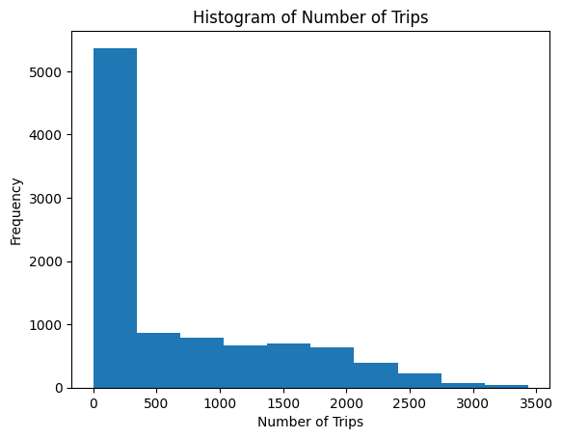
Histogram of Number of Trips

Slide 4
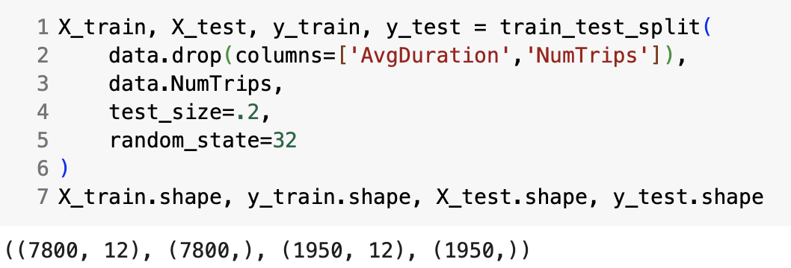
Preprocessing – Train Test Split
As the first step of preprocessing, the data was split into training and test splits.
Features 'AvgDuration’ and 'NumTrips’, were dropped from the X split.
The following code snippet contains the splitting logic as well as the shape of the split data.

Slide 5
Preprocessing – Data Pipeline
Before building the pipeline, each feature was assigned to categorical, numeric, or ordinal buckets.
The following features were determined to be categorical: 'BikeType', 'TripType', 'month', 'day_of_week’
The following features were determined to be numeric: 'AvgHumidity', 'MinTemp’, 'MaxTemp', 'Windy', 'Rain', 'Snow’
Year was determined as an ordinal feature in the pipeline.
Numeric values were scaled using MinMax Scaler and categorical features were onehotencode

Slide 6
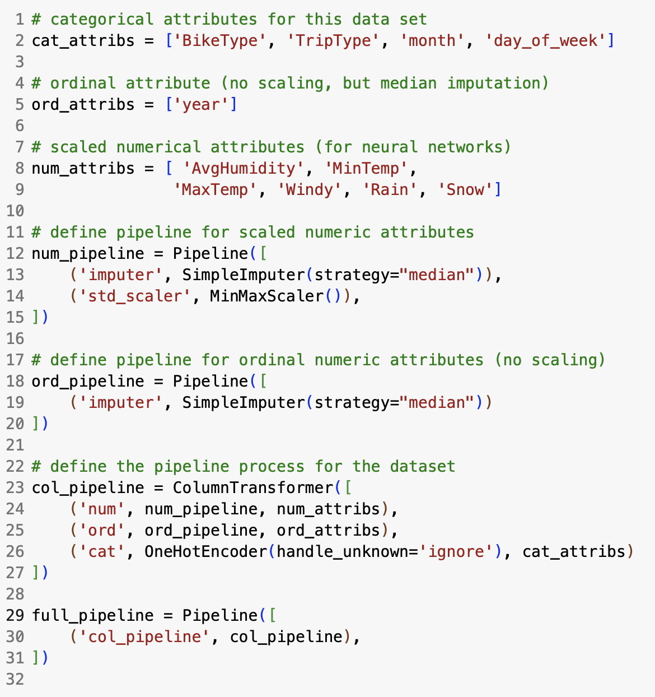
Preprocessing – Data Pipeline
The following contains the code and the logic behind the pipeline.
After fitting and transforming the pipeline on X_train, X_train dataset ended up with the shape (7800, 30).
After transforming the pipeline on X_test, the test dataset ended up with the shape (1950, 30).

Slide 7
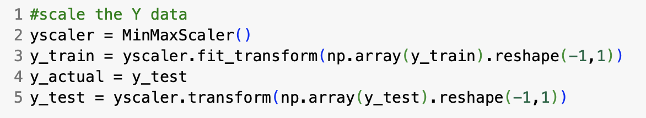
Preprocessing – Scaling Y values
MinMax Scaler was initiated and assigned to a variable called yscaler.
The scaler was fitted and transformed on y_train and transformed on y_test.
The values were scaled to fall between (0,1).

Slide 8
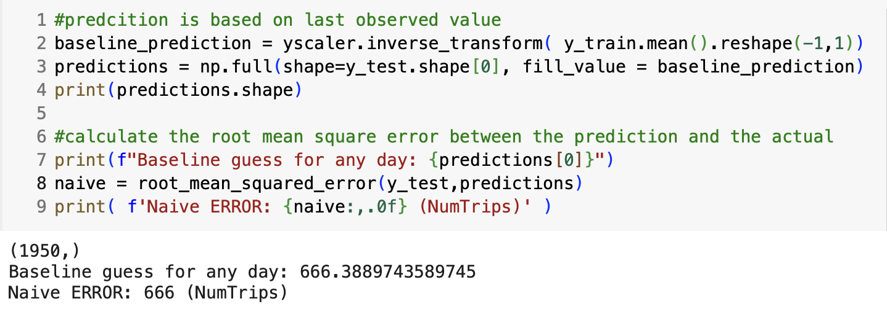
Establishing a Baseline
A baseline was established based on the mean of the training dataset.
Since the y values were scaled before, it was necessary to un-scale them to get interpretable values.
Root mean squared error was chosen as a metric to gauge the model.

Slide 9
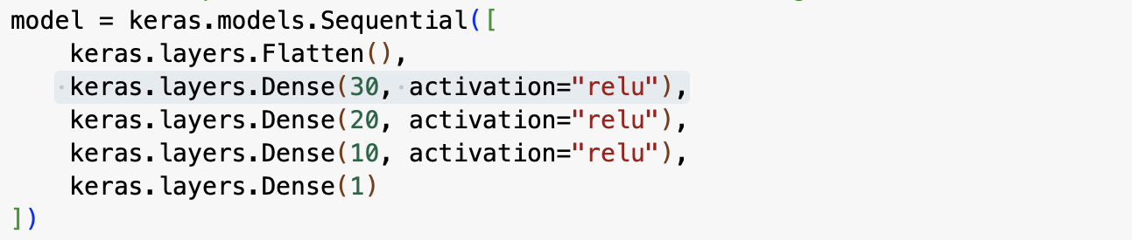
Building the Neural Network
The backend was cleared to make sure the previous runs will not affect the model.
The initial model contains an input layer, an output layer, and three layers in between.
The layers in between have 30,20,10 neurons respectively, with Relu as the activation function

Slide 10
Building the Neural Network
Then, the model was compiled with mean squared error as the loss function, adam as the optimizer and root mean square error as the gauge for model performance.
After a few tries with different learning rates, it was decided to run the initial model with a learning rate of 0.00001.
Early stopping was initialized, and the patience was set to 10 to better understand model behavior.
Lastly, the model was fitted on X_train and y_train, with a batch size of 32, 500 epochs, taking advantage of the shuffle function and early stopping.

Slide 11
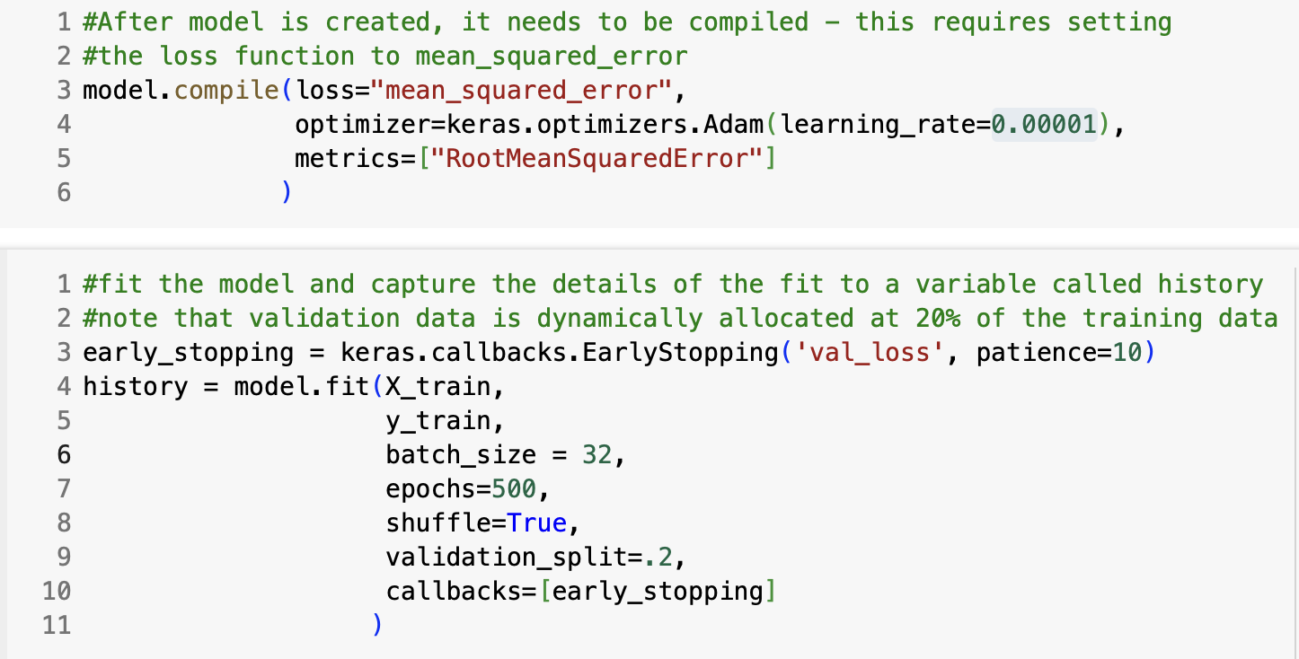
Building the Neural Network
The following code snippets depict the initial model before tuning.

Slide 12
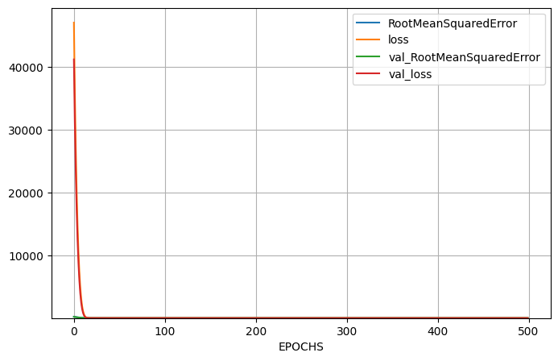
Building the Neural Network – Evaluating Initial Performance
To further understand the initial model, the learning curve was plotted.

Slide 13
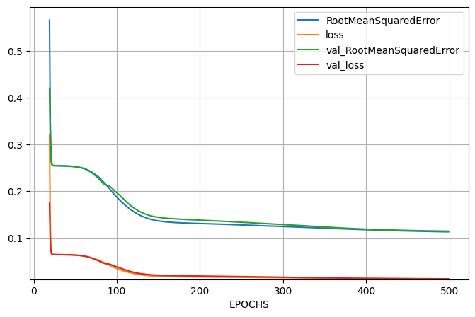
Building the Neural Network – Evaluating Initial Performance
Since the value of the loss function in the first epoch was large, the behavior of the learning curve as we get to smaller epochs was not reflected and scaled well in the provided function.
The following graph looks at epoch 19 and onwards when the loss value is smaller than 1.

Slide 14
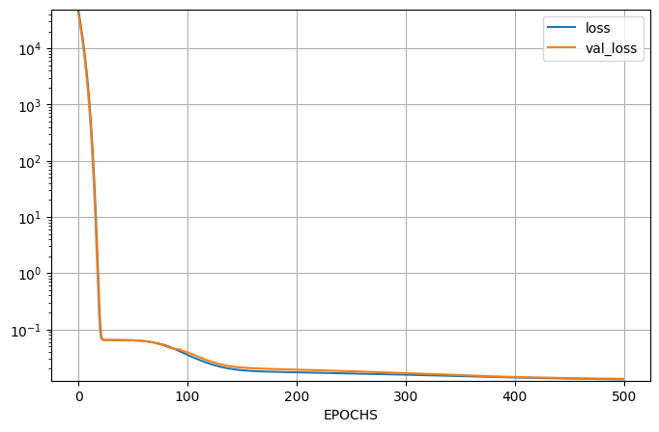
Building the Neural Network – Evaluating Initial Performance
Lastly, another graph was plotted based on the logarithmic scale of loss and validation loss to further understand the behavior of the network.

Slide 15
Building the Neural Network – Evaluating Initial Performance
Initially RMSE of both training and test data were analyzed.
Since these values are previously scaled, it is hard to interpret the loss metric.
To combat that RMSE of both training and test splits were evaluated on un-scaled data.
The following slide contains code snippets of evaluations on un-scaled train and test data as well as the results.

Slide 16
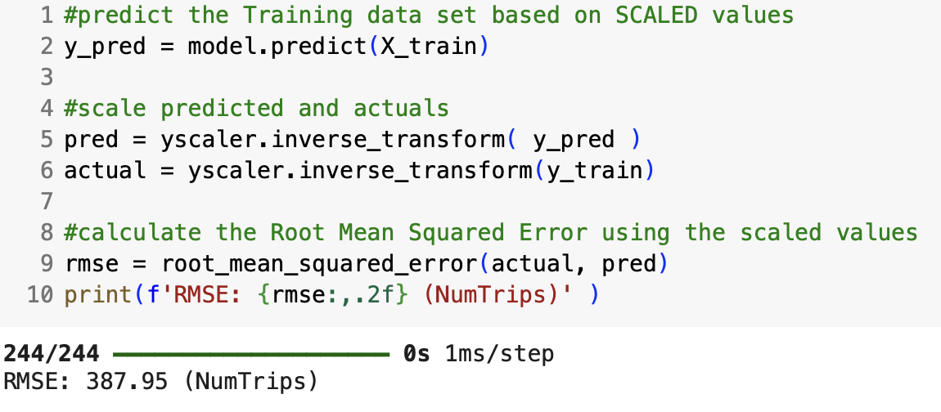
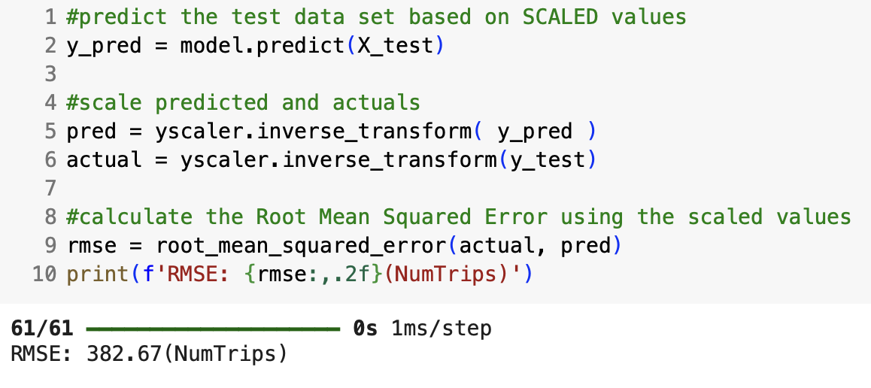
Building the Neural Network – Evaluating Initial Performance
As demonstrated in the following code snippets, RMSE of training and test are very similar, indicating that the model is not overfitting.

Slide 17
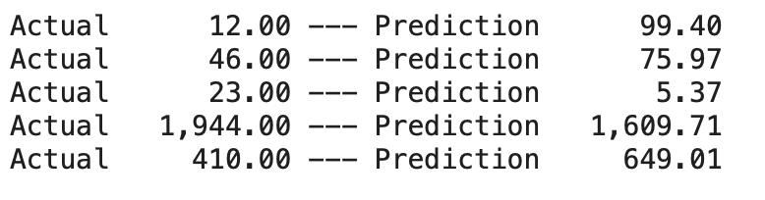
Building the Neural Network – Evaluating Initial Performance
Lastly, for the first 5 test cases, actual values were compared to predictions.

Slide 18
Tuning the Neural Network
To begin tuning, the backend was cleared.
Then, function reg_model_builder was defined to build a customizable Keras regression model that can be fed to Keras tuner.
The functions starts with choosing Adam or SGD as optimizers.
Then the function selects a learning rate from the provided range.
After that, the function choose the number of neurons (units) and number of hidden layers.
Following that, the function gets into the model architecture, starting with a flatten layer, adding the number of units, and using relu as the activation function. The output layer is Dense(1), since the regression model is trying to predict only one value.
Notes:
Model assessment should include assessment as to the validity of the model and if it is overfitting or underfitting the data

Slide 19
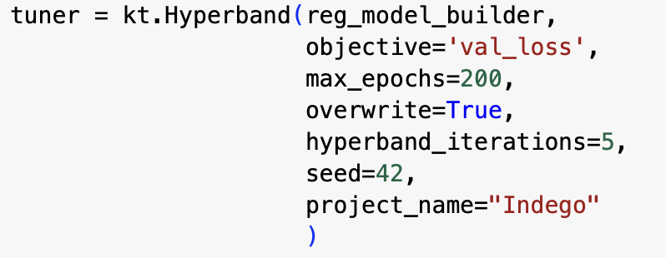
Tuning the Neural Network
A hyperband tuning object is initialized with the following characteristics.
The results of the tuner object is fed to a search function to find the ideal parameters.
Notes:
Model assessment should include assessment as to the validity of the model and if it is overfitting or underfitting the data

Slide 20
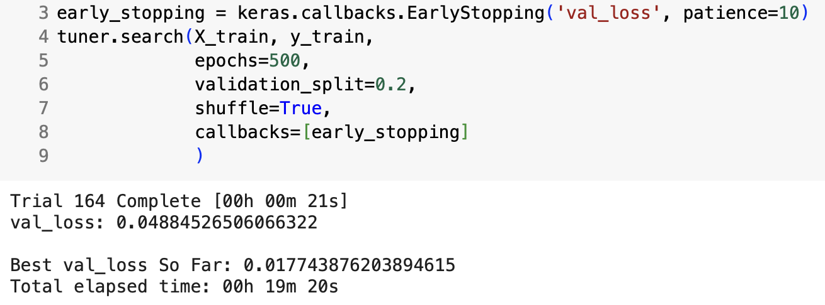
Tuning the Neural Network
The following code snippet depicts the search object, number of tries, best validation score, and the time it took.
Notes:
Model assessment should include assessment as to the validity of the model and if it is overfitting or underfitting the data

Slide 21
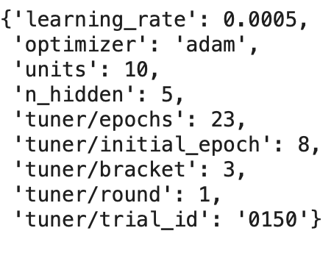
Tuning the Neural Network
Based on the search, the following values were deemed the best for the following parameters.
Then the model called best_model was initialized based on the parameters above.
After clearing the backend, the best model was fitted on X_train and y_train.
Notes:
Model assessment should include assessment as to the validity of the model and if it is overfitting or underfitting the data

Slide 22
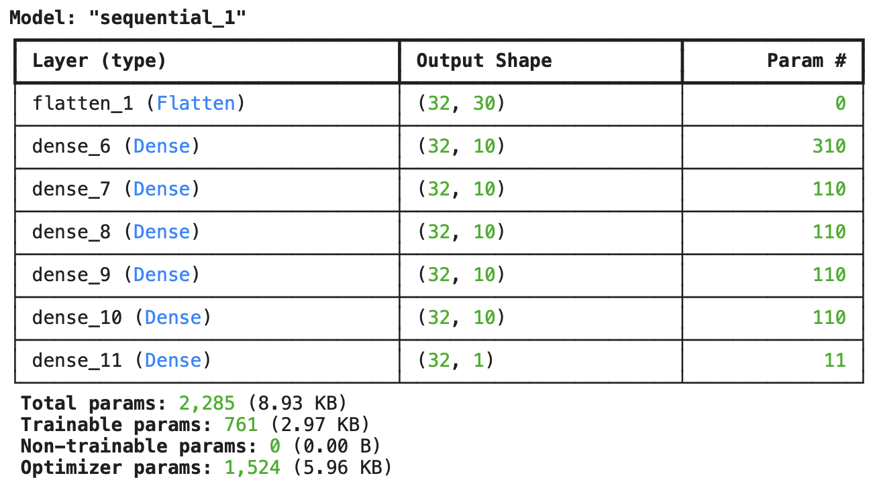
Tuning the Neural Network – The Best Model
The following is the summary of the best model.
Notes:
Model assessment should include assessment as to the validity of the model and if it is overfitting or underfitting the data

Slide 23
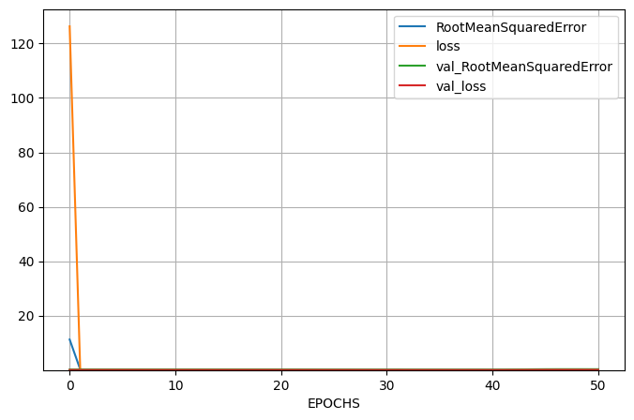
Tuning the Neural Network – The Best Model
The following is the learning graph for the best tuned model starting from epoch 1.
Notes:
Model assessment should include assessment as to the validity of the model and if it is overfitting or underfitting the data

Slide 24
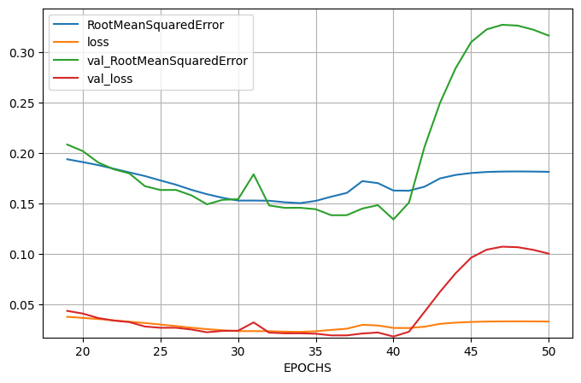
Tuning the Neural Network – The Best Model
Just like before, the modified learning cure plot was drawn to reflect the model’s behavior after epoch 19.
Notes:
Model assessment should include assessment as to the validity of the model and if it is overfitting or underfitting the data

Slide 25
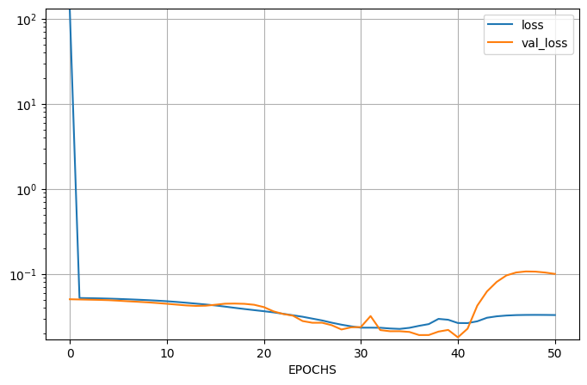
Tuning the Neural Network – The Best Model
The following graph depicts loss and val_loss, scaled logarithmically.
Notes:
Model assessment should include assessment as to the validity of the model and if it is overfitting or underfitting the data

Slide 26
Learning Curve – The Original Model
To compare the effects of tuning, the following is the original learning curve.
Notes:
Model assessment should include assessment as to the validity of the model and if it is overfitting or underfitting the data

Slide 27
Learning Curve – Tuned Model
To compare the effects of tuning, the following is the learning curve plot after tuning. As seen here it is hard to compare and interpret the graphs when graphed from epoch one where the model display a large amount of loss.
Notes:
Model assessment should include assessment as to the validity of the model and if it is overfitting or underfitting the data

Slide 28
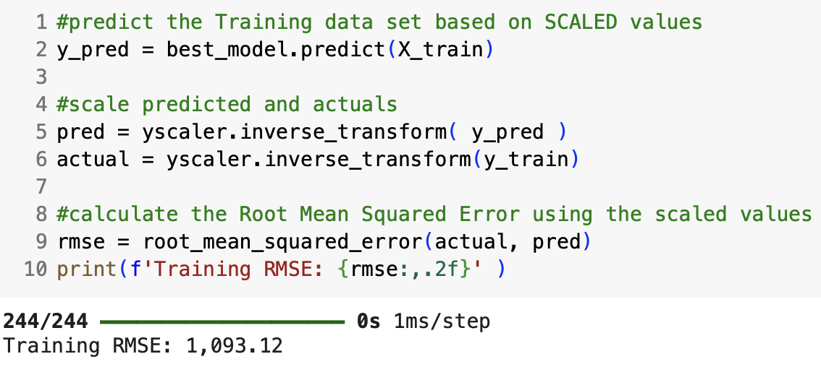
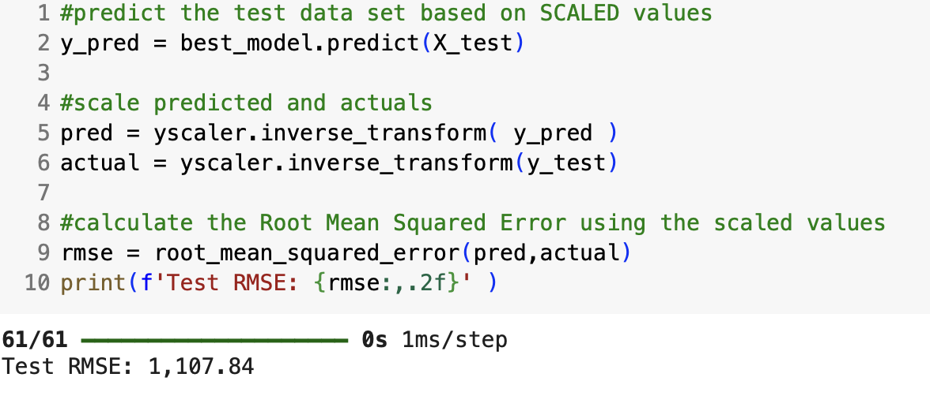
Evaluating the Best Model
Just like before, RMSE of test and training splits based on scaled values were compared.
Notes:
Model assessment should include assessment as to the validity of the model and if it is overfitting or underfitting the data

Slide 29
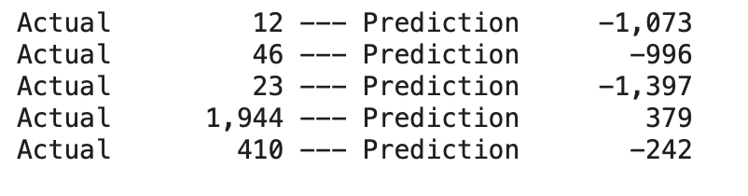
Evaluating the Best Model
Similarly, the actual values and prediction values were compared for 5 data points.
The model seemed to have gotten worse after tuning as reflected both here and in the previous slides, even predicting negative values.
The negative predicted values prompted further investigation into the model architecture. To combat them, another experiment was conducted, this time using relu as the activation function in the output layer. More details will be depicted in the following slides.
Notes:
Model assessment should include assessment as to the validity of the model and if it is overfitting or underfitting the data

Slide 30
Predicting the Number of Trips
As per assignment instructions, the prediction dataset was downloaded, and the same preprocessing logic was applied.
The data was transformed based on the pipeline defined earlier.
Lastly, the number of trips were predicted using both the original model and the tuned one.
Notes:
Model assessment should include assessment as to the validity of the model and if it is overfitting or underfitting the data

Slide 31
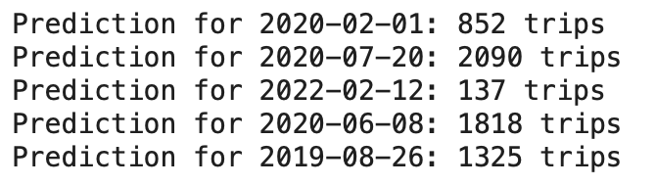
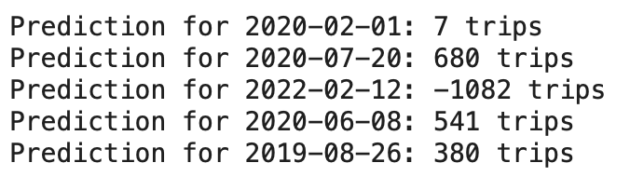
Predicting the Number of Trips – Original and Tuned Model
The following is the prediction results based on the original model defined and without any tuning.
The following is the prediction results based on the tuned model.
Notes:
Model assessment should include assessment as to the validity of the model and if it is overfitting or underfitting the data

Slide 32
Predicting the Number of Trips – Original and Tuned Model
As seen in the previous slide, there is a significant difference between tuned (Test RMSE of 1107.84) and untuned original model (Test RMSE of 382.67) .
At this point, it seems that the original model has performed better both in terms of predictions (the model did not predict negative values) and RMSE.
This demonstrates that Keras tuner is not perfect and some level of intuition is still necessary.
Hyperband may give worse results because it stops models too early based on initial performance, potentially discarding neural networks that improve later in training.
Notes:
Model assessment should include assessment as to the validity of the model and if it is overfitting or underfitting the data

Slide 33
Predicting the Number of Trips – Relu and Tuned Model
It was decided to repeat the experiment one more time, this time with using relu as the activation function of the output layer.
After tuning the best parameters for a model with relu as the activation function for the output, there were no significant change in RMSE metrics.
The results of the model using hyperband tuning and relu in the last layer is not great.
More time and computing power could possibly enable the use of hyperband tuning with a different batch size, more options for learning rates, number of hidden layers, number of neurons, larger epoch values, and hyperband iterations.
Notes:
Model assessment should include assessment as to the validity of the model and if it is overfitting or underfitting the data

Slide 34
Analysis of Data – Classification
As the assignment instructions indicate, the goal for the second part is to train a classification model to predict average duration into three buckets.
Much of preprocessing before the pipeline remains the same.
As mentioned in the instructions, the column average duration was binned into three classes and the results were saved to a new column called DurationType:
Quick (an average duration 25 minutes or less)
Average (an average duration of more than 25 minutes but less than 55 minutes)
Cruising (an average duration of more than 55 minutes)
Notes:
Model assessment should include assessment as to the validity of the model and if it is overfitting or underfitting the data

Slide 35
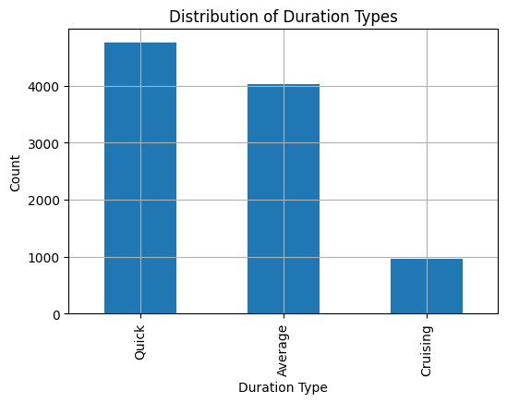
Analysis of Data – Classification
To understand the distribution of each class, the following histogram was plotted.
As seen in the graph, there are some class imbalances that may need more attention later.
Notes:
Model assessment should include assessment as to the validity of the model and if it is overfitting or underfitting the data

Slide 36
Classification Preprocessing
The duration types were encoded using LabelEncoder, to prepare them for neural networks and saved to a new column called duration label.
This will be useful later allowing for easy decoding.
Then next step would be train test split.
Notes:
Model assessment should include assessment as to the validity of the model and if it is overfitting or underfitting the data

Slide 37
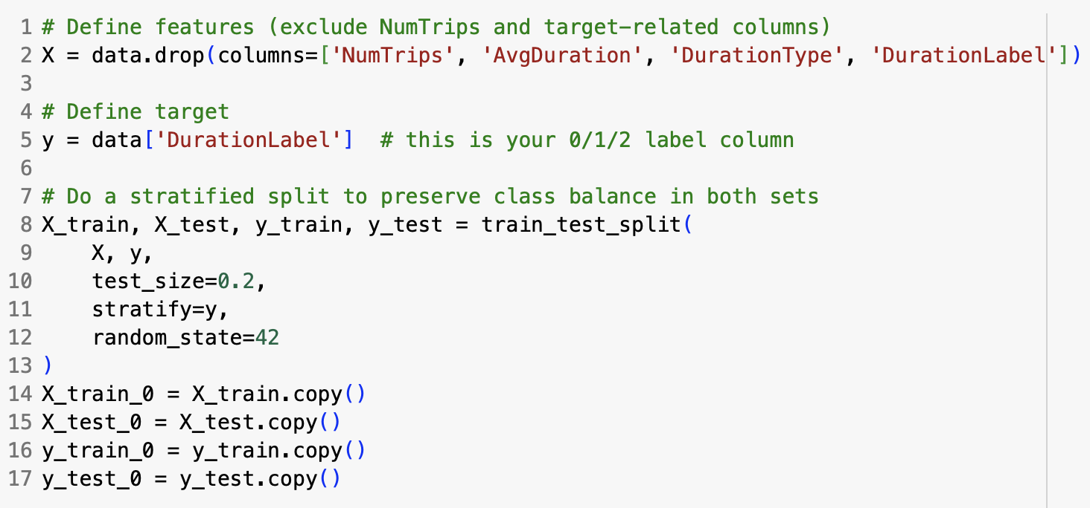
Classification Preprocessing – Train Test Split
X and y were defined making sure to not include highly correlated features in the X dataset.
A stratified split was done to preserve the class balance.
Lastly, a copy of each split was made allowing the option to explore over sampling later on.
Notes:
Model assessment should include assessment as to the validity of the model and if it is overfitting or underfitting the data

Slide 38
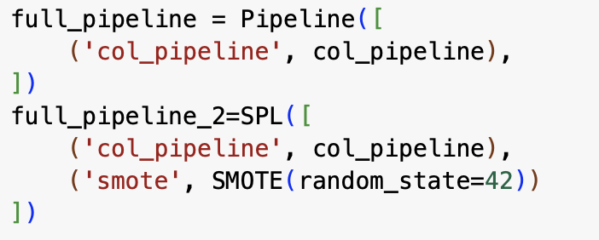
Classification Preprocessing – Pipeline
The pipeline logic remains the same as before. The only difference being another pipeline object was created allowing for oversampling using SMOTE.
Notes:
Model assessment should include assessment as to the validity of the model and if it is overfitting or underfitting the data

Slide 39
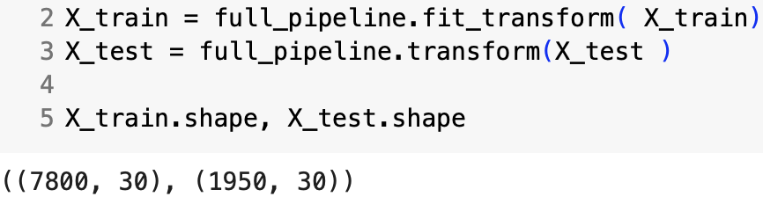
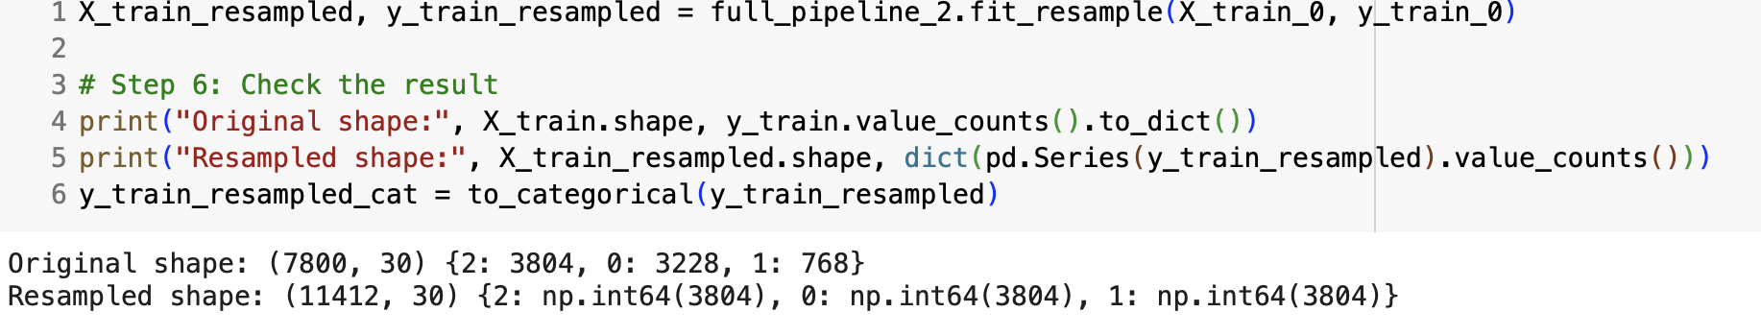
Classification Preprocessing – Pipeline
Similar to before both pipelines were fitted and transformed on training data and transformed on the test data. The following code snippets shows the shape of the data with and without oversampling.
Notes:
Model assessment should include assessment as to the validity of the model and if it is overfitting or underfitting the data

Slide 40
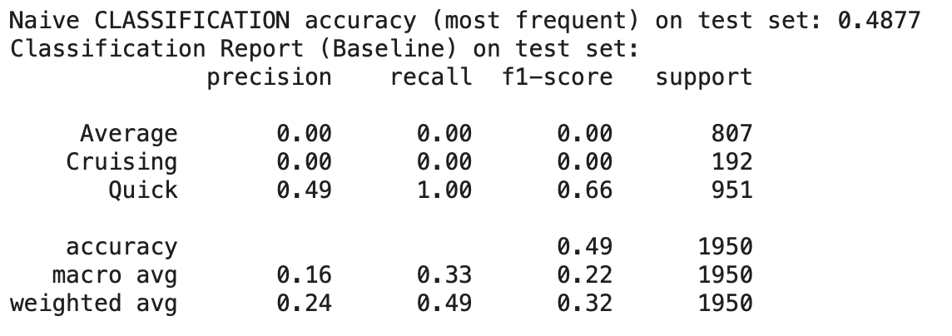
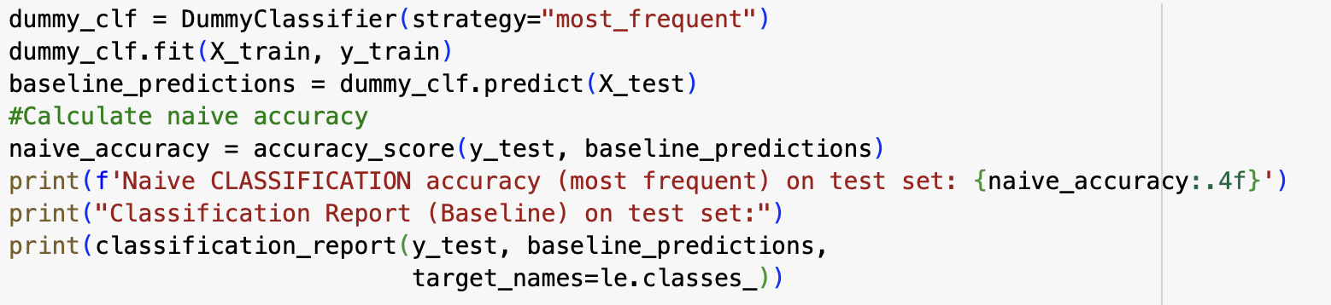
Classification – Establishing a Baseline
Dummy classifier with most frequent strategy was utilized to establish a baseline.
The following is the code and results of classification report on the test sets.
Notes:
Model assessment should include assessment as to the validity of the model and if it is overfitting or underfitting the data

Slide 41
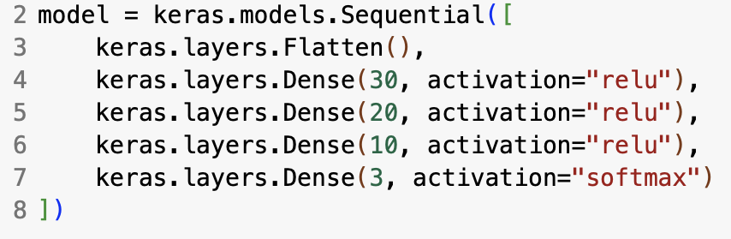
Building the Classification Neural Network
Before building the initial model, the backend was cleared.
Similar to before, the initial network was built with 3 hidden layers.
The output layer contains three neurons as we are trying to classify three values and utilizes softmax as the activation function.
Notes:
Model assessment should include assessment as to the validity of the model and if it is overfitting or underfitting the data

Slide 42
Building the Classification Neural Network
The model was then compiled using categorical_crossentropy, since the problem is essentially a multiclass classification, which essentially quantifies the difference between a model's predicted probability distribution and the true label distribution.
Adam was chosen as the initial optimizer with learning rate of .00001.
Accuracy was chosen as the evaluation metric.
Notes:
Model assessment should include assessment as to the validity of the model and if it is overfitting or underfitting the data

Slide 43
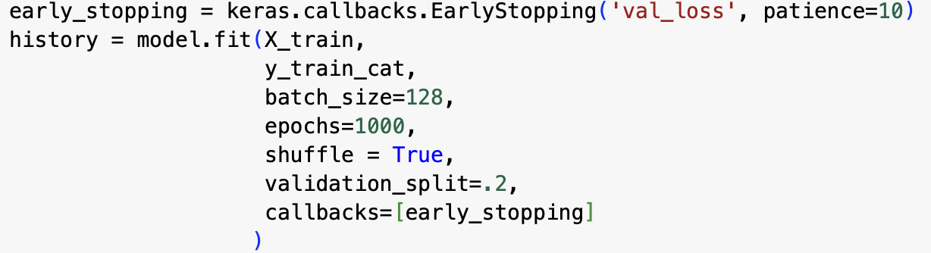
Building the Classification Neural Network
Next, the initial model was fitted on X_train and y_train_cat (encoded y_train) with the following settings.
Early stopping with patience of 10 was utilized.
20% of the training data is used for validation.
Notes:
Model assessment should include assessment as to the validity of the model and if it is overfitting or underfitting the data

Slide 44
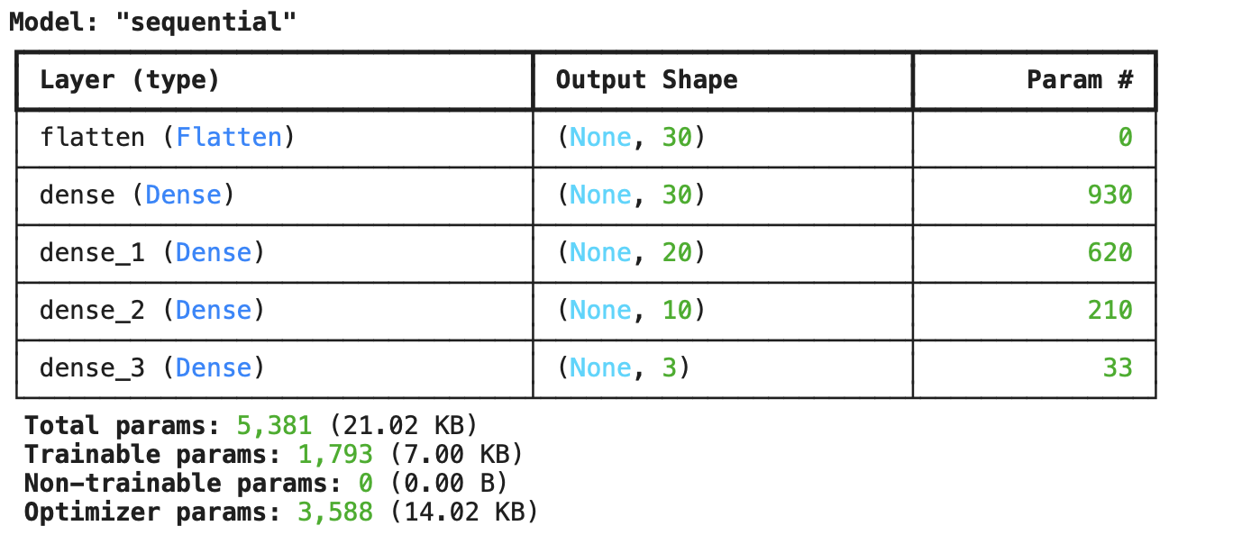
Building the Classification Neural Network
Here is the summary of the initial model.
Notes:
Model assessment should include assessment as to the validity of the model and if it is overfitting or underfitting the data

Slide 45
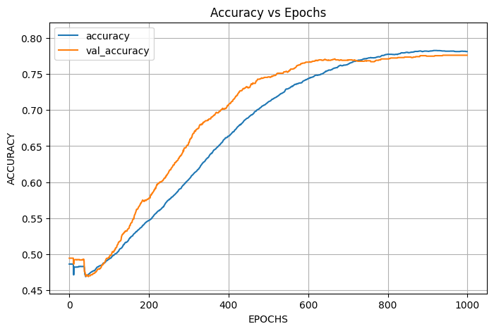
Building the Classification Neural Network – Evaluating Initial Performance
The following graph shows how accuracy and validation accuracy change as the epochs increase.
Notes:
Model assessment should include assessment as to the validity of the model and if it is overfitting or underfitting the data

Slide 46
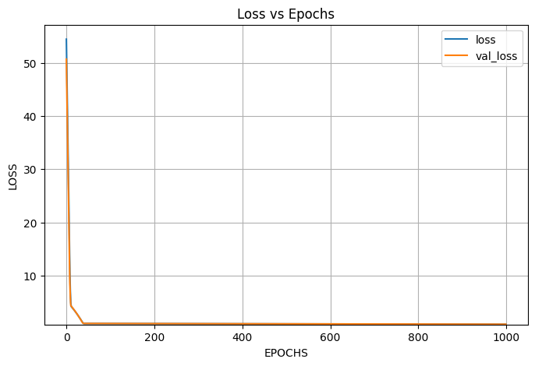
Building the Classification Neural Network – Evaluating Initial Performance
The following graph shows how loss and validation loss change as the model goes through epochs.
Notes:
Model assessment should include assessment as to the validity of the model and if it is overfitting or underfitting the data

Slide 47
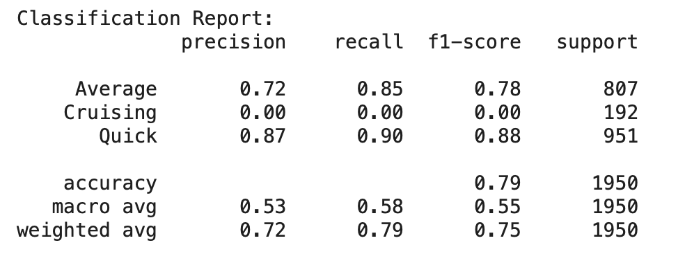
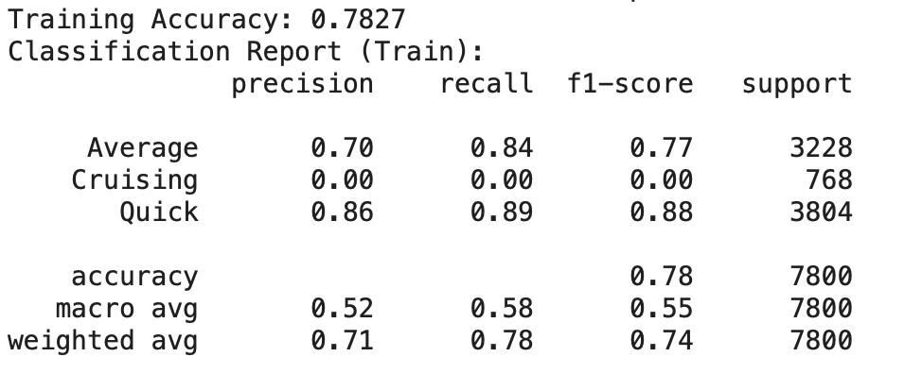
Building the Classification Neural Network – Evaluating Initial Performance
Bellow is the classification report on the test splits (on the left) and training splits (on the right).
As seen here the test and training accuracy are very close, indicating the model is not overfitting.
Notes:
Model assessment should include assessment as to the validity of the model and if it is overfitting or underfitting the data

Slide 48
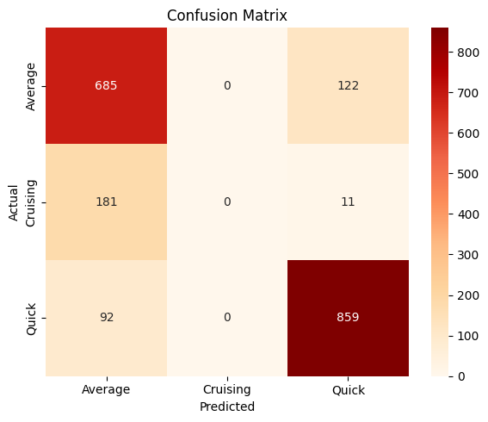
Building the Classification Neural Network – Evaluating Initial Performance
To further understand the initial model behavior, the confusion matrix of the classification model was plotted.
Notes:
Model assessment should include assessment as to the validity of the model and if it is overfitting or underfitting the data

Slide 49
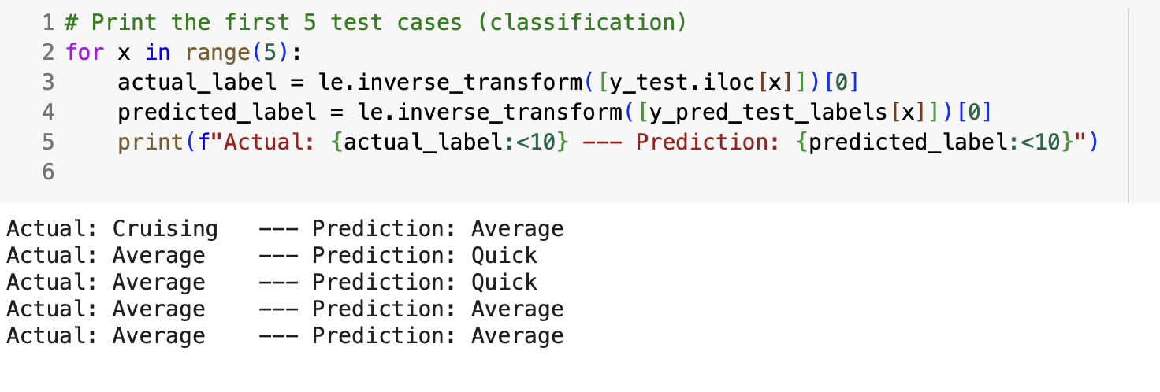
Building the Classification Neural Network – Evaluating Initial Performance
Just as before, for the first 5 data points, actual answers and the ones predicted by the model is compared.
A common theme is that the model has trouble predicting Cruising class.
To further investigate this issue, another classifier models was built on oversampled data.
Notes:
Model assessment should include assessment as to the validity of the model and if it is overfitting or underfitting the data

Slide 50
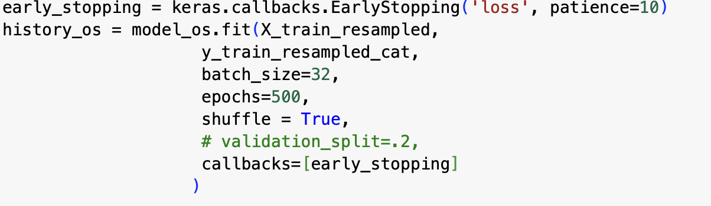
Building the Classification Neural Network – Evaluating Initial Performance on Oversampled Data
The model architecture for the most part remains the same.
To save time, the models is fitted using 500 epochs as opposed to 1000.
Notes:
Model assessment should include assessment as to the validity of the model and if it is overfitting or underfitting the data

Slide 51
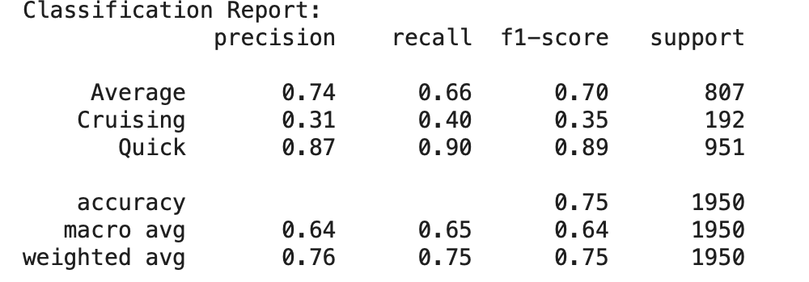
Building the Classification Neural Network – Evaluating Initial Performance on Oversampled Data
The following is the classification report on the test data set using oversampled data.
As demonstrated, there was not a significant difference between accuracy when training the models on initial dataset and training the model on oversampled data.
However, a quick glance at the new classification reports shoes the model is better able predict cruising class which is the smallest class in the original data.
Notes:
Model assessment should include assessment as to the validity of the model and if it is overfitting or underfitting the data

Slide 52
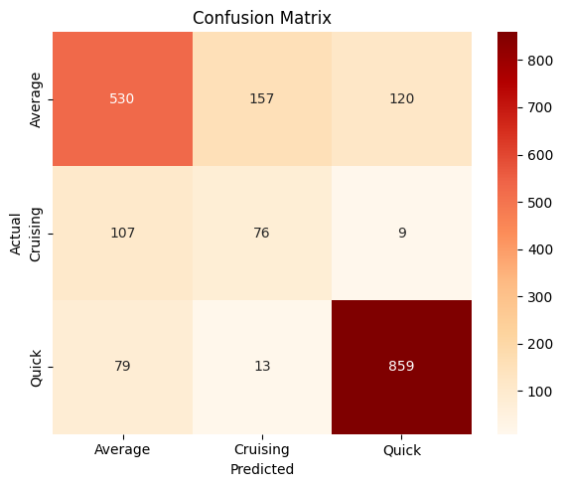
Building the Classification Neural Network – Evaluating Initial Performance on Oversampled Data
The following is the confusion matrix on the test data set using oversampled data.
As shown, 76 cruising samples were correctly identified, much better than zero when the model was trained without oversampling the data.
Notes:
Model assessment should include assessment as to the validity of the model and if it is overfitting or underfitting the data

Slide 53
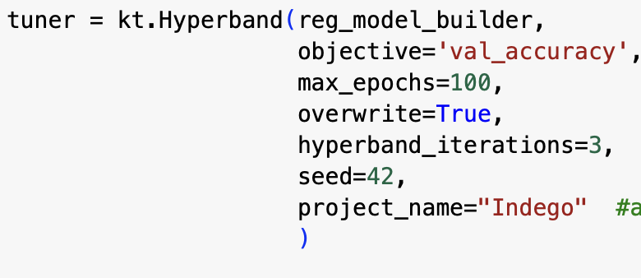
Tuning the Classification Neural Network
As the next step, a hyperband object was created, and the provided model builder function was fed to the hyperband object.
Notes:
Model assessment should include assessment as to the validity of the model and if it is overfitting or underfitting the data

Slide 54
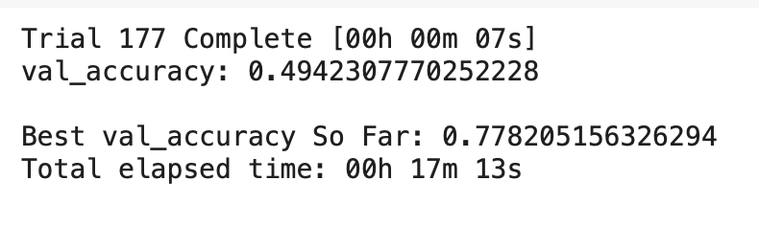
Tuning the Classification Neural Network
After clearing the backend, the tuner searched for the best values.
Notes:
Model assessment should include assessment as to the validity of the model and if it is overfitting or underfitting the data

Slide 55
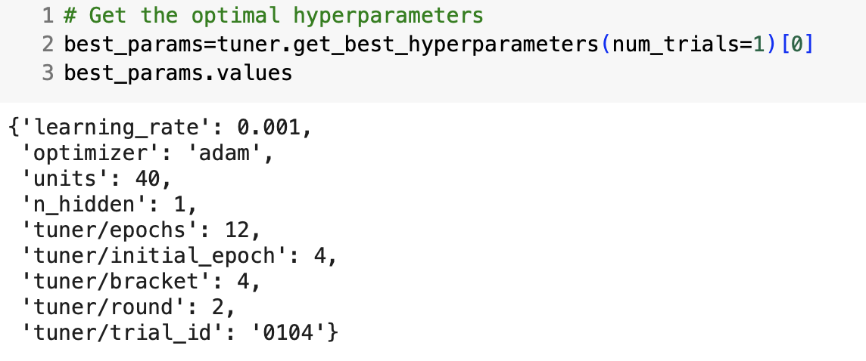
Tuning the Classification Neural Network
Based on the the values that the tuner object found, a new model was trained on the original data.
The following values are the best parameters found by the tuner.
Notes:
Model assessment should include assessment as to the validity of the model and if it is overfitting or underfitting the data

Slide 56
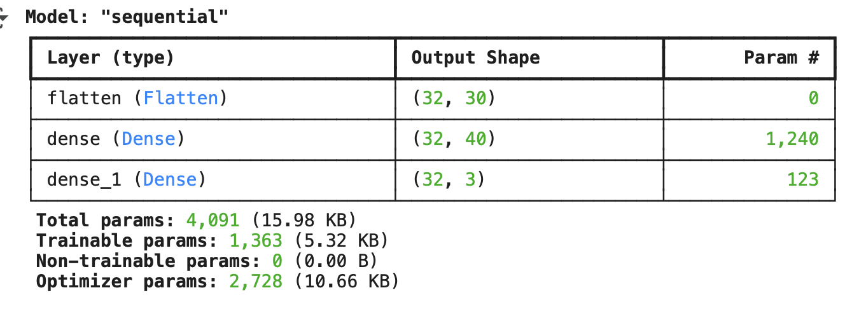
Tuning the Classification Neural Network
Summary of the best model
Notes:
Model assessment should include assessment as to the validity of the model and if it is overfitting or underfitting the data

Slide 57
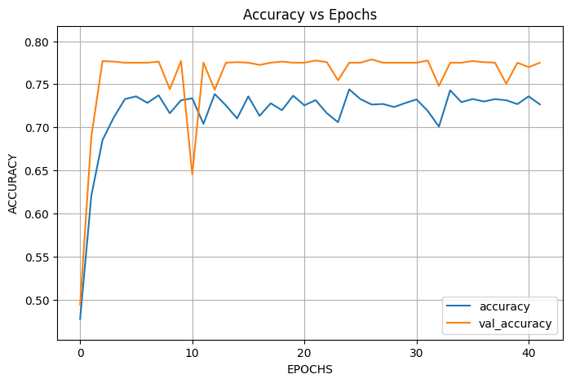
Tuning the Classification Neural Network
Accuracy vs epochs graph is shown below.
Notes:
Model assessment should include assessment as to the validity of the model and if it is overfitting or underfitting the data

Slide 58
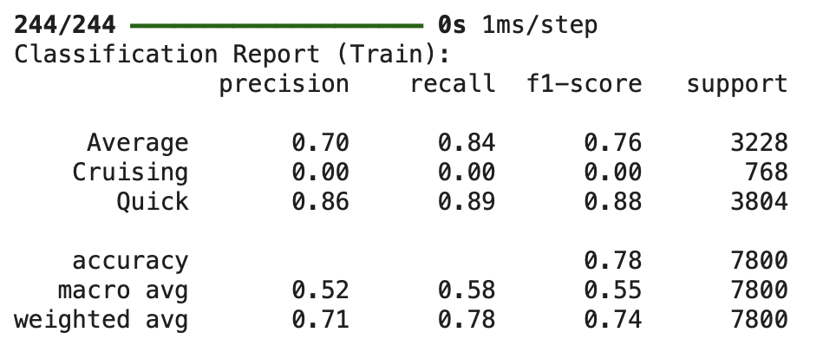

The Optimal Classification Neural Network
The model trained with the optimal hyperparameters on the original training data (and not the oversampled training data) was used to classify the train and test splits.
The following is the classification reports for both train and test splits.
Notes:
Model assessment should include assessment as to the validity of the model and if it is overfitting or underfitting the data

Slide 59

The Optimal Classification Neural Network
The tuned classification model was used to classify 5 instances and was compared to the actual answers.
Notes:
Model assessment should include assessment as to the validity of the model and if it is overfitting or underfitting the data

Slide 60

Predicting Classes on the Prediction Dataset
The best model found by the tuner(without oversampling) was used to predict the classes on the provided prediction dataset.
Notes:
Model assessment should include assessment as to the validity of the model and if it is overfitting or underfitting the data

Slide 61

Predicting Classes on the Prediction Dataset Using Oversampled Training Data
The original model (and not the tuned one) was trained on the oversampled training data and was used to classify the 5 instances provided in the prediction dataset.
Notes:
Model assessment should include assessment as to the validity of the model and if it is overfitting or underfitting the data

Slide 62

Predicting Classes on the Prediction Dataset Using the Original Untuned Model
To compare the effects of tuning and oversampling to a control model, the original untuned model was used to classify the instances provided in the prediction dataset.
The final answers remain the same across the three classifiers utilized in this part of the assignment.
Notes:
Model assessment should include assessment as to the validity of the model and if it is overfitting or underfitting the data

Slide 63
Insights
Feature engineering and scaling were essential to model performance. Time-based features like month, day_of_week, and weather variables helped the model detect seasonal and weather-related patterns in bike usage.
Learning rate had a significant impact on model stability; while 0.00001 with Adam led to strong performance, extreme values during tuning caused divergence or slow learning.
The original manually designed network outperformed the tuned model both in terms of RMSE and prediction realism.

Slide 64
Insights Continued
Hyperparameter tuning via Hyperband was not always effective, especially in regression. While efficient, it may prematurely stop promising models. This limitation was evident as the tuned model underperformed compared to the manually designed model.
In classification however, the result of hyperband tuning was comparable to the manually designed network.
Trip prediction showed strong generalization between training and test sets, as evidenced by near-identical RMSE values. This suggests the network captured stable underlying patterns without overfitting.

Slide 65
Insights Continued
Evaluation using RMSE on unscaled targets was critical. Without this, performance would be hard to interpret due to normalized output.
Neural networks require careful architectural decisions. The number of layers and the number of neurons within each layer should be proportional to data features and number of samples.
Insight and expert knowledge could be especially useful when designing and tuning a neural network.

Slide 66
Recommendations
Human intuition is essential and should be used along side automated tunings. Hyperband may miss models that take longer to improve. It is best to start simple and manually evaluate results and then use iterative tuning.
Search space should be extended thoughtfully in tuning. Future tuning could benefit from a broader learning rate range, varying batch sizes, and longer training time.
Predicted number of trips can be used for operational planning. These trip forecasts could help Indego optimize bike availability, station stocking, and staffing during high-demand periods.
More experimenting should be done especially with regularization and dropout. This may reduce noise in more complex models and further improve generalization.

